Slide 1
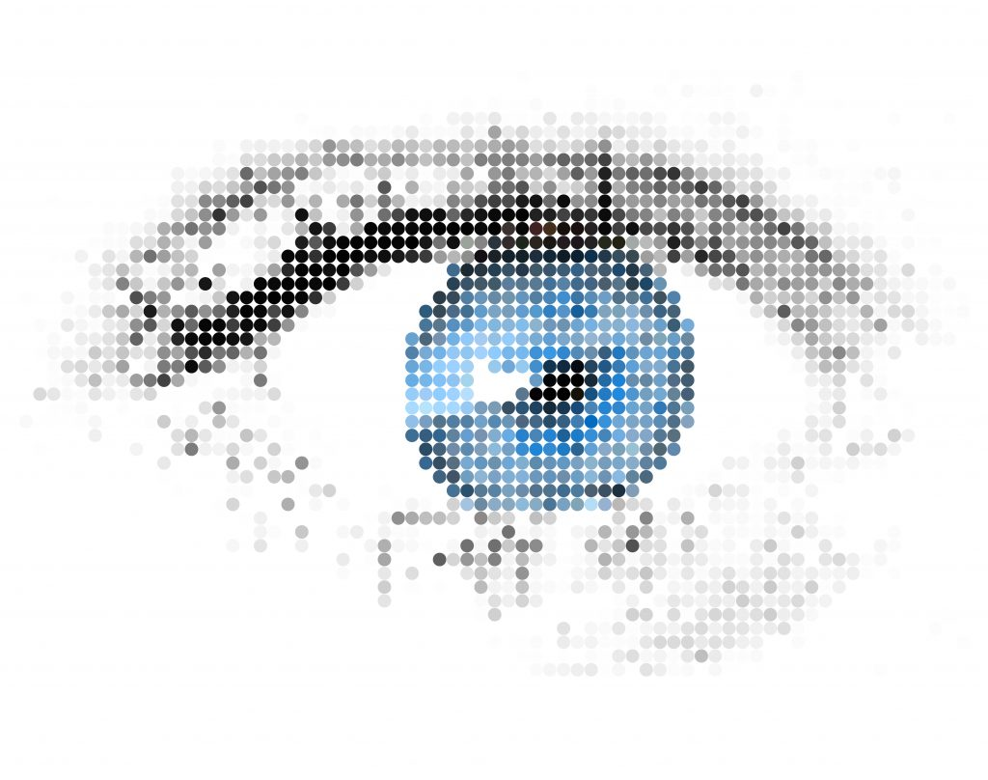
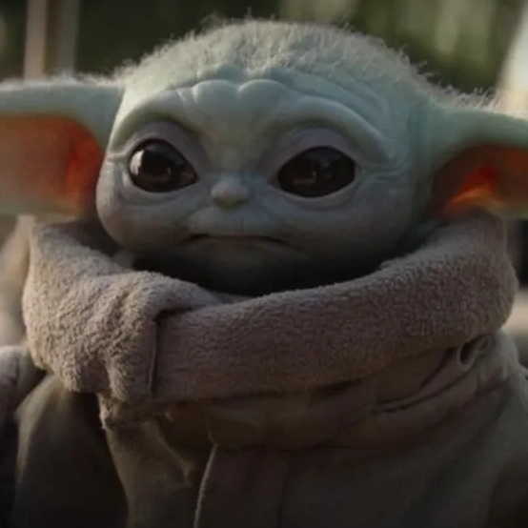
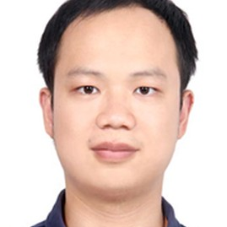
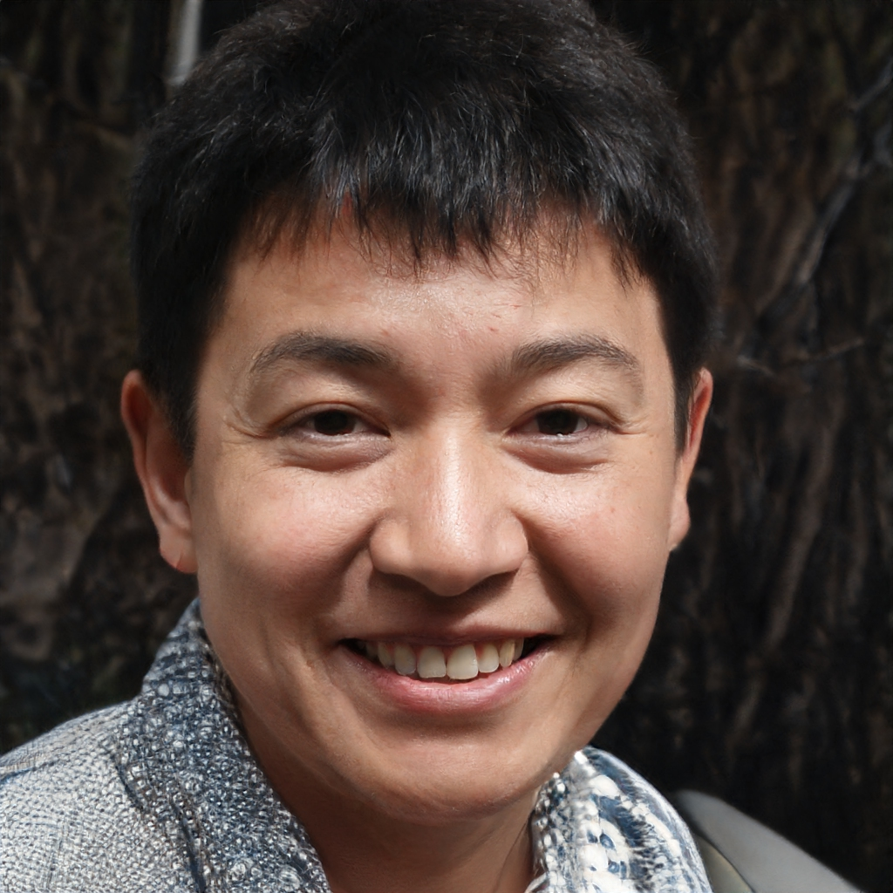

Computer Vision 2
Assignment 3: 2D-to-3D for Face Swapping
TAs: Partha Das, Pengwan Yang, Minh Ngo

Slide 2
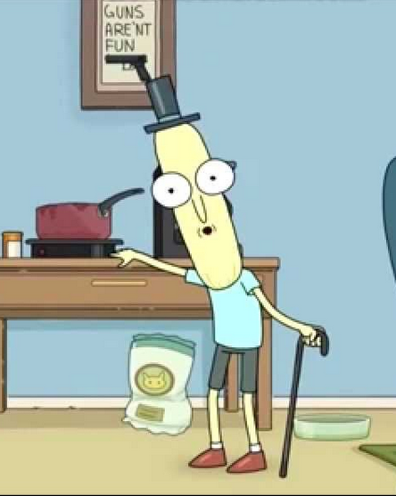
In the previous episode
Many ways to get a 3D model
Depth information available (RGB-D camera)?
Iterative Closest Point! (Assignment 1)
Multiple images of an object from different views?
Structure from Motion! (Assignment 2)

Slide 3
In the previous episode
Many ways to get a 3D model
Depth information available (RGB-D camera)?
Iterative Closest Point! (Assignment 1)
Multiple images of an object from different views?
Structure from Motion! (Assignment 2)
One single monocular image?
Intrinsic Image Decomposition!

Slide 4
In the previous episode
Many ways to get a 3D model
Depth information available (RGB-D camera)?
Iterative Closest Point! (Assignment 1)
Multiple images of an object from different views?
Structure from Motion! (Assignment 2)
One single monocular image?
Intrinsic Image Decomposition!
An object changes shape and appearance over time?
????? <- Assignment 3

Slide 5
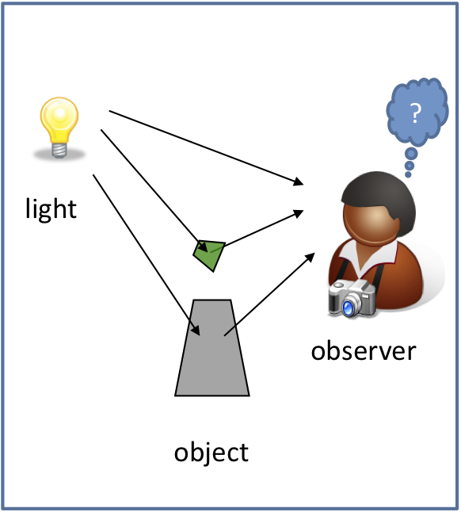
Object color system
Source: rit.edu

Slide 6
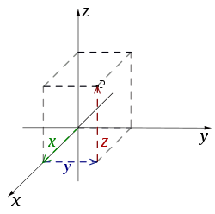
Coordinate systems
Top-down view, ignoring Oy,
Left-handed vs Right-handed coordinate systems:
x
Z
Z
x
Ox ⊥ Oy ⊥Oz
3D point representation:
P = {x, y, z}

Slide 7
Camera (observer)
Z
0
x

Slide 8
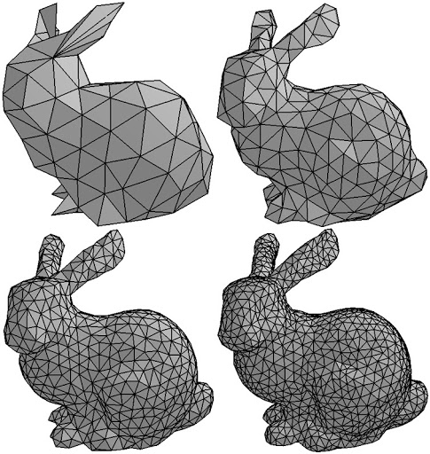
3D model parametrization
Z
0
x
Each row stores 3 indexes of
elements from X

Slide 9
Object movement
XR^{T}
The same as Rp_{i}
Rotation:
Z
0
x
XR^{T} + t
Translation:
Z
0
x

Slide 10
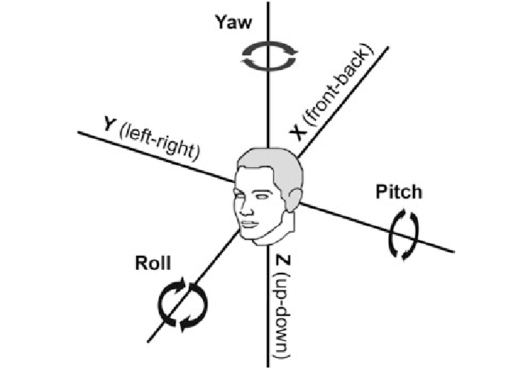
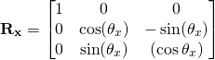
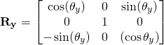
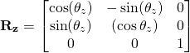
Object movement

Slide 11
Light
Z
0
x

Slide 12
Object movement: translation
t
Z
0
x
XR^{T} + t
Alternative representation: (X + t)R^{T}

Slide 13
Shape changes

Slide 14
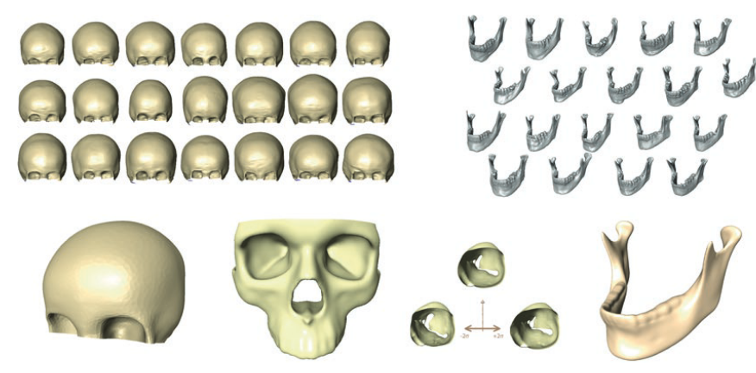
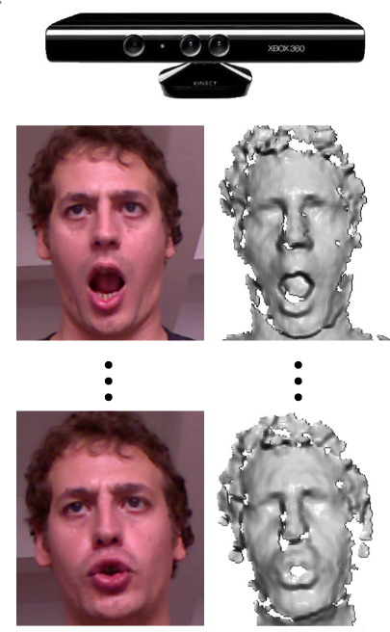

Statistical Shape Models
Source: Cao et al., FaceWarehouse: a 3D Facial Expression Database for Visual Computing. IEEE Transactions on Visualization and Computer Graphics, 2014.
Ambellan et al., Statistical Shape Models: Understanding and Mastering Variation in Anatomy. Biomedical Visualization, 2019.

Slide 15
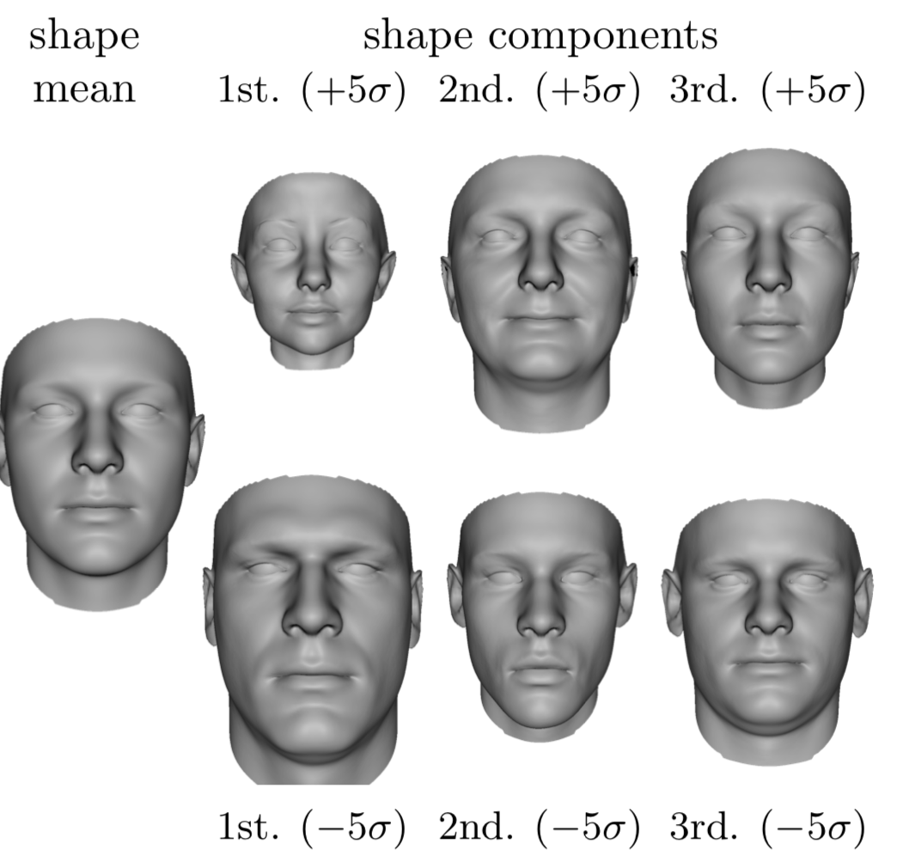
Statistical Shape Models
Modeling a new object:
Mean
PCs
Unknown
Std
Source: Paysan et al (2009)

Slide 16
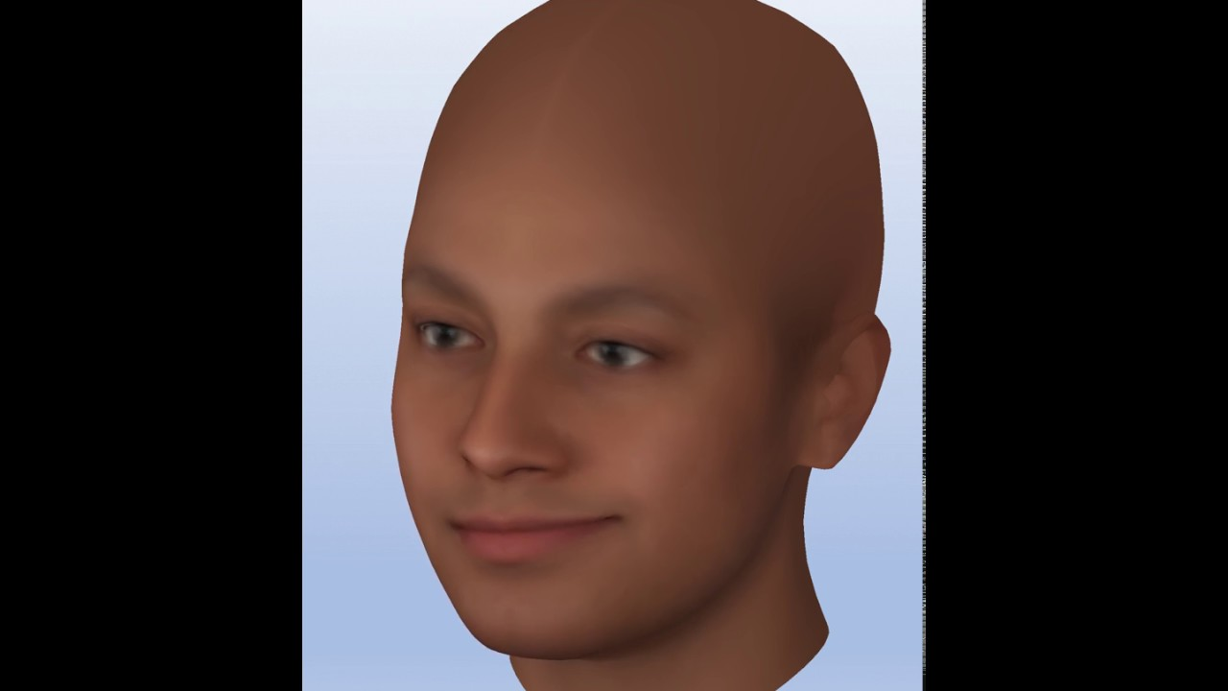
Multilinear PCA Model
Modeling multiple properties:
Face identity
Expression modeling

Slide 17
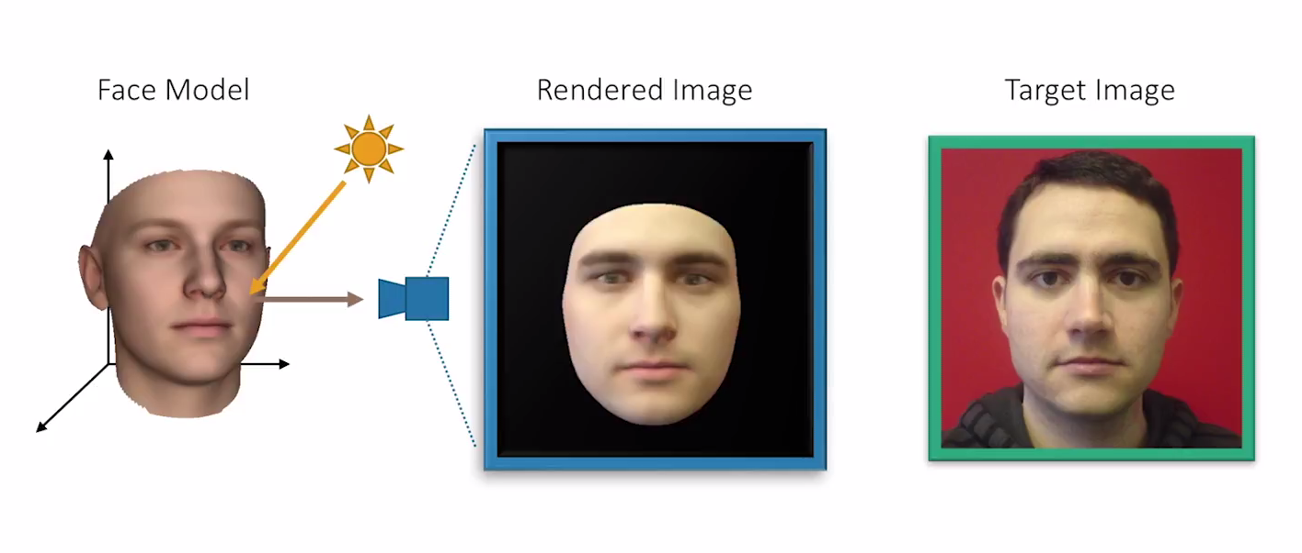
Analysis-by-synthesis
Latent parameters x
Source: Egger et al (2018)

Slide 18
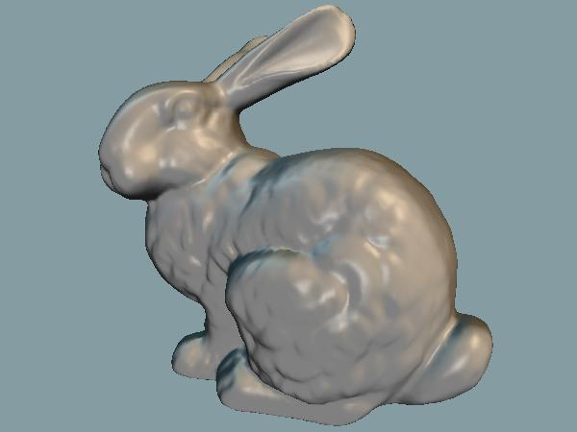
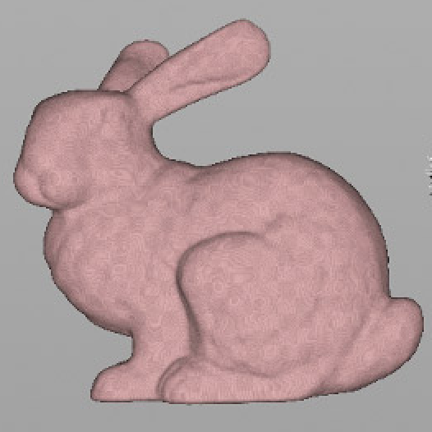
Analysis-by-synthesis
Can be anything
Classical Computer Vision Methods:
f(x)
y (gt)
Initialise x parameters
Predict x parameters
Image synthesis f(x)
Compare with GT: E(f(x), y)
Update x

Slide 19
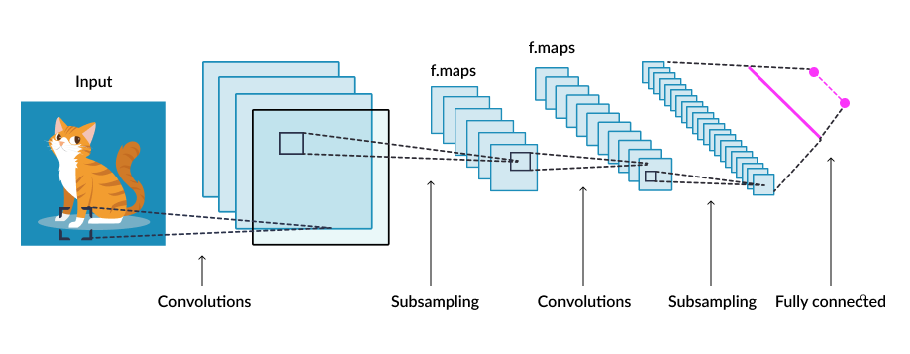
Analysis-by-synthesis
Can be anything
Deep Learning-based Methods:
f(x)
y (gt)
Initialise x Xparameters
Predict x parameters
Image synthesis f(x)
Compare with GT: E(f(x), y)
Update x

Slide 20
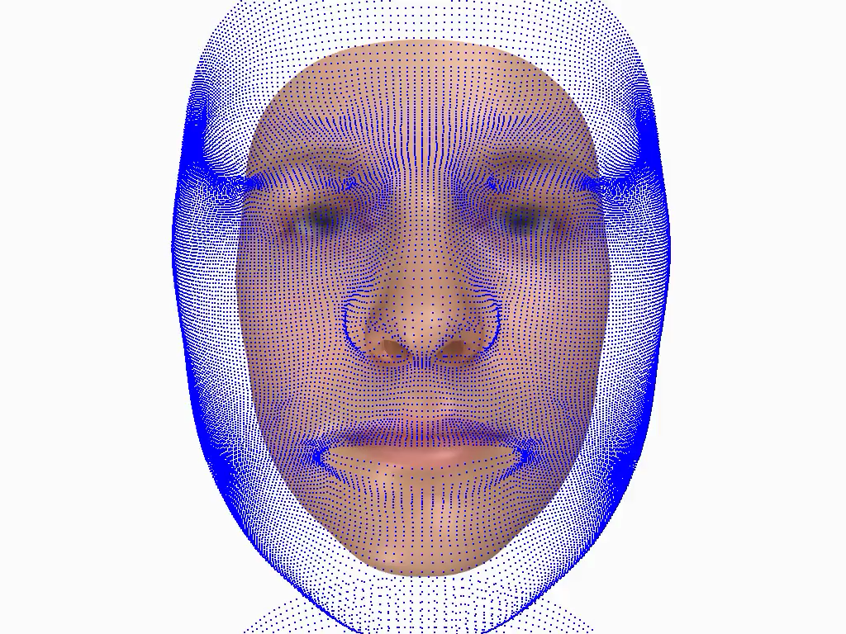
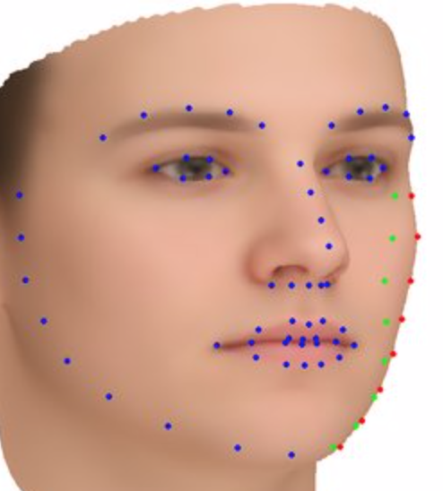
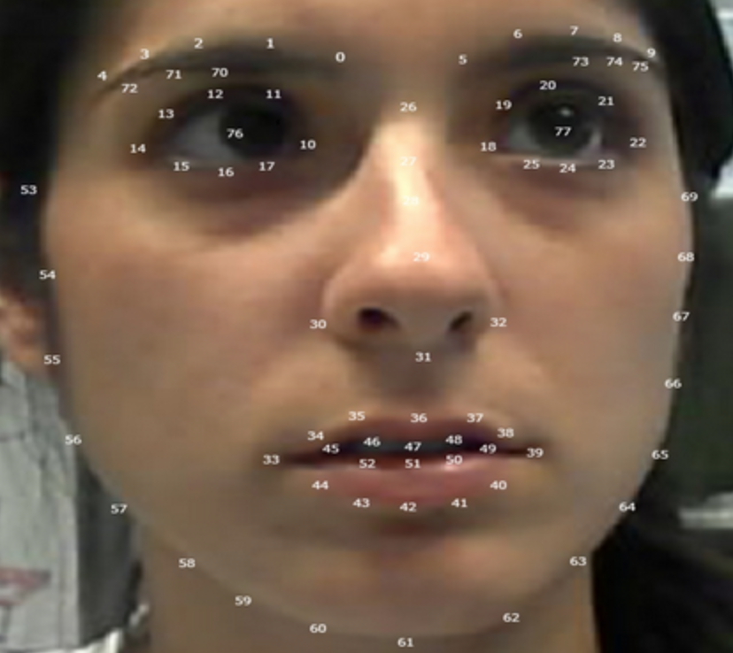
Energy minimization
I - input image
F - landmark ground truth
I,F

Slide 21
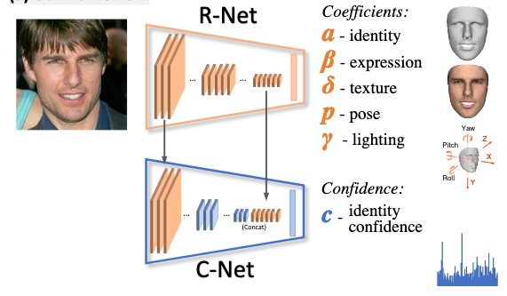
DNN-based 2D-to-3D face reconstruction
Source: Deng et al (2020)

Slide 22
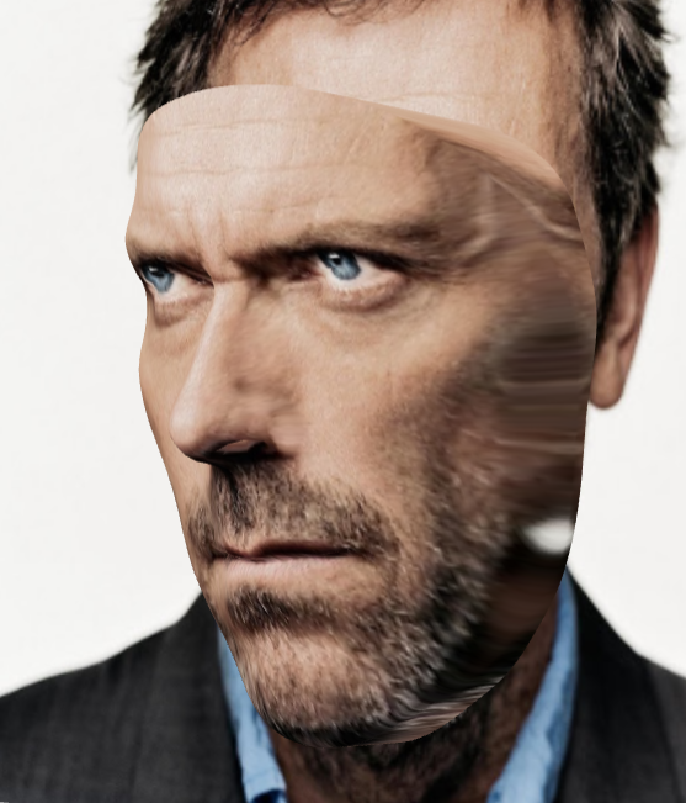
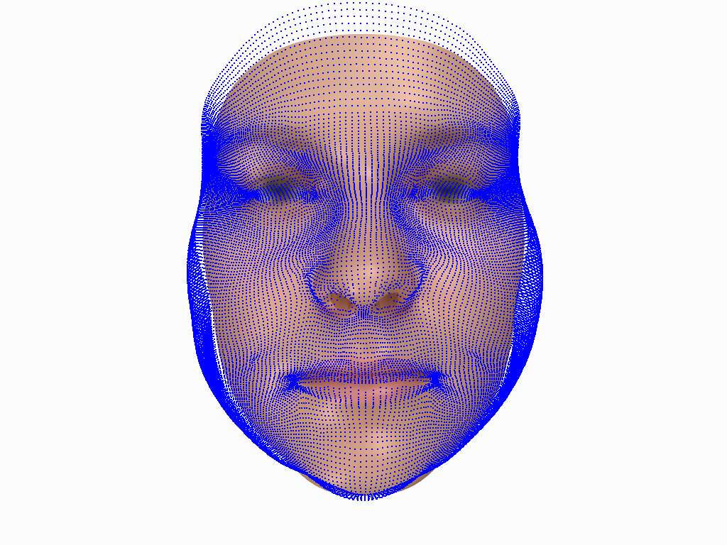
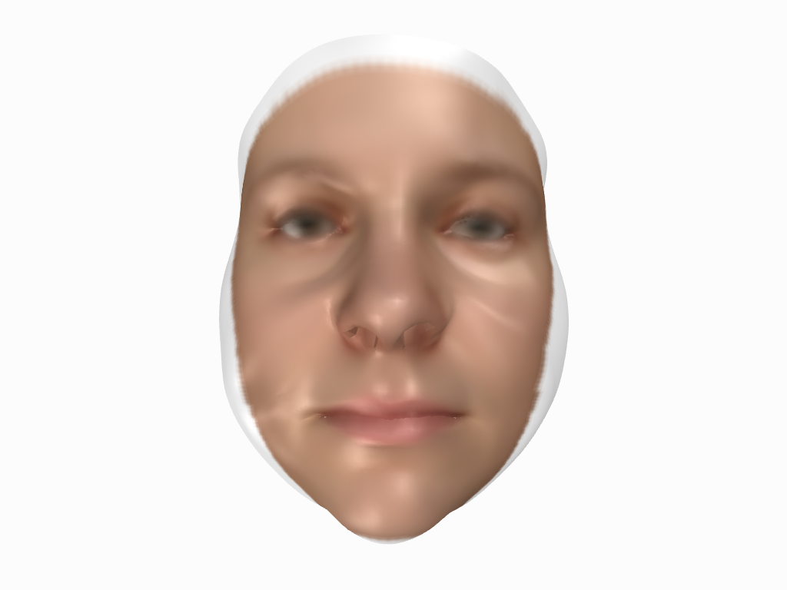
Texturing
projection find a correspondent RGB
color from an image
Source: http://yourface.3duniversum.com/House

Slide 23
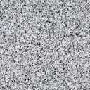
Generative Adversarial Network
Get rid of explicit generative model for complex, high-dimensional distribution
samples from a simple distribution (random noise)
learn to transform to training distribution with a neural network
Output: Sample from
training distribution
Using two-player game!
Generator
Input: Random noise (z)

Slide 24

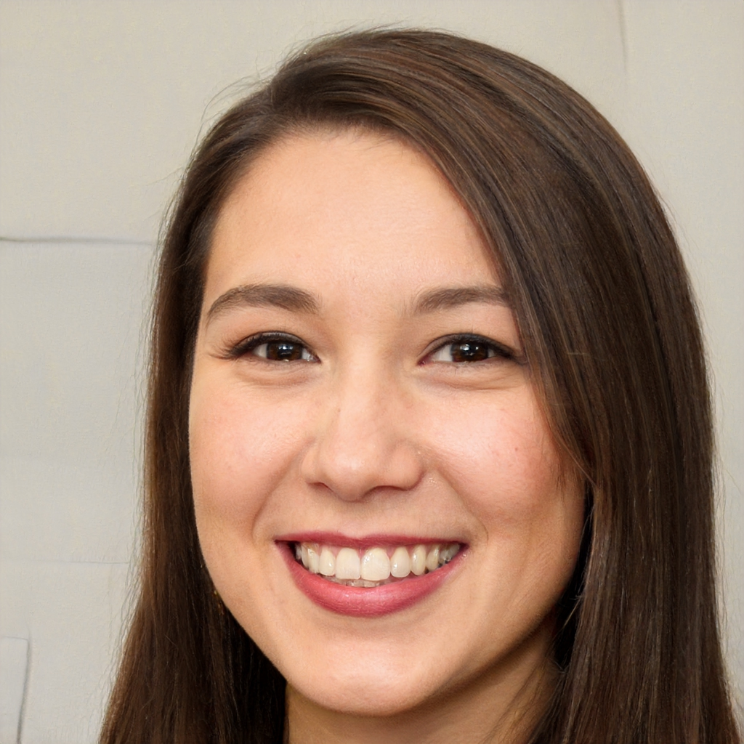




Generative Adversarial Network
Generator: try to generate fake images in the same distribution with training samples
Discriminator: try to distinguish between fake and real images
Real or Fake
Discriminator
Output: Sample from
training distribution
Generator
Input: Random noise (z)
Source: thispersondoesnotexist.com

Slide 25
Generative Adversarial Network
Minimax objective function
Real or Fake
maximize
Discriminator
Output: Sample from
training distribution
Generator
minimize
Input: Random noise (z)
Source: thispersondoesnotexist.com

Slide 26
Generative Adversarial Network
Minimax objective function
Output: Sample from
training distribution
Generator is taken out
to generate images
Generator
Input: Random noise (z)

Slide 27
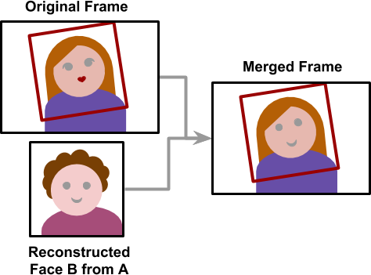
Blending
Generate new faces from a conditioned distribution not random noise
Source: https://www.alanzucconi.com/2018/03/14/introduction-to-deepfakes/

Slide 28
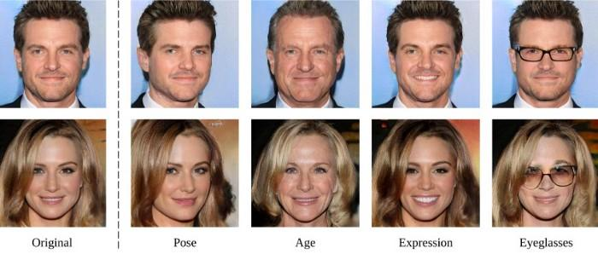
Blending
Conditions could be a pose, expression, …
Source: https://www.alanzucconi.com/2018/03/14/introduction-to-deepfakes/

Slide 29
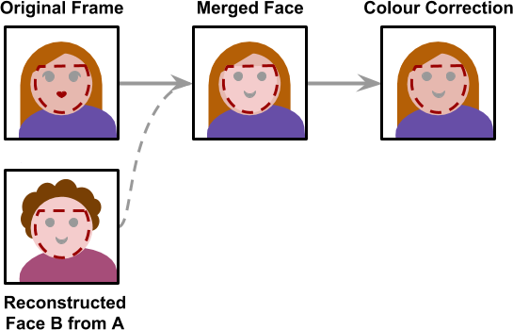
Blending
Overall training process
Blending
Source: https://www.alanzucconi.com/2018/03/14/introduction-to-deepfakes/

Slide 30

Applications
Performance capturing https://www.youtube.com/watch?v=sXN9IHrnVVU&t=40s
Face dubbing and reenactment
Avatar creation
Face beautification / relighting
Face tracking
And a lot more!

Slide 31
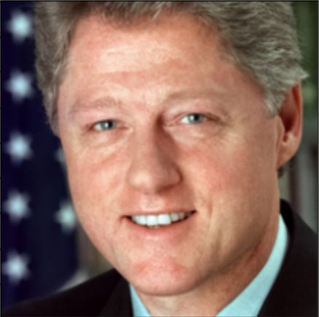
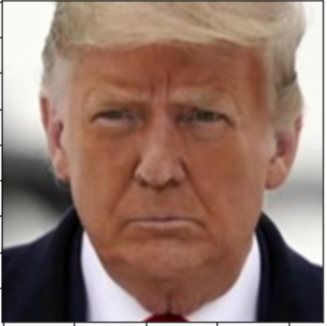
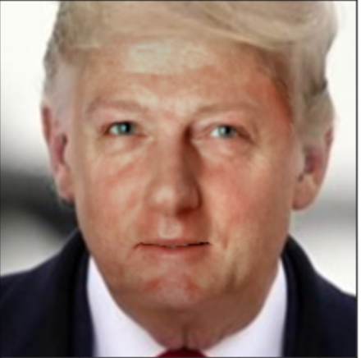
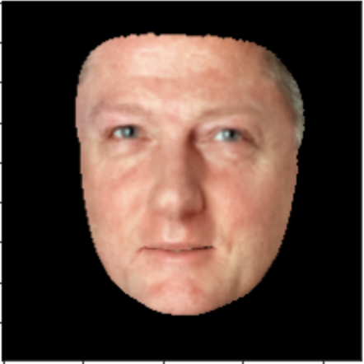
Application on Face Swapping
Foreground
Background
2D-to-3D Reconstruction
2D-to-3D Reconstruction
Face Texture
+
3D model
=

Slide 32


Application on Face Swapping
Foreground
Background
2D-to-3D Reconstruction
2D-to-3D Reconstruction
Face Texture
+
3D model
=

Slide 33
Assignment 3
Given two images (foreground and background)
Replace face from 1 image by one from another
Reconstruct 3D point model of 2 input faces
Map face texture of 1 face to a 3D point cloud of another
Blend 2 parts to produce final result

Slide 34
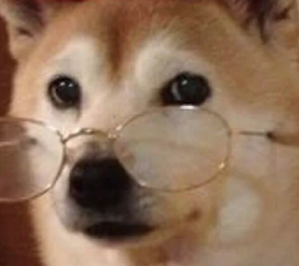
questions?
Interested in face analysis / 2D-to-3D related projects? Drop us an email!

